Slide 1

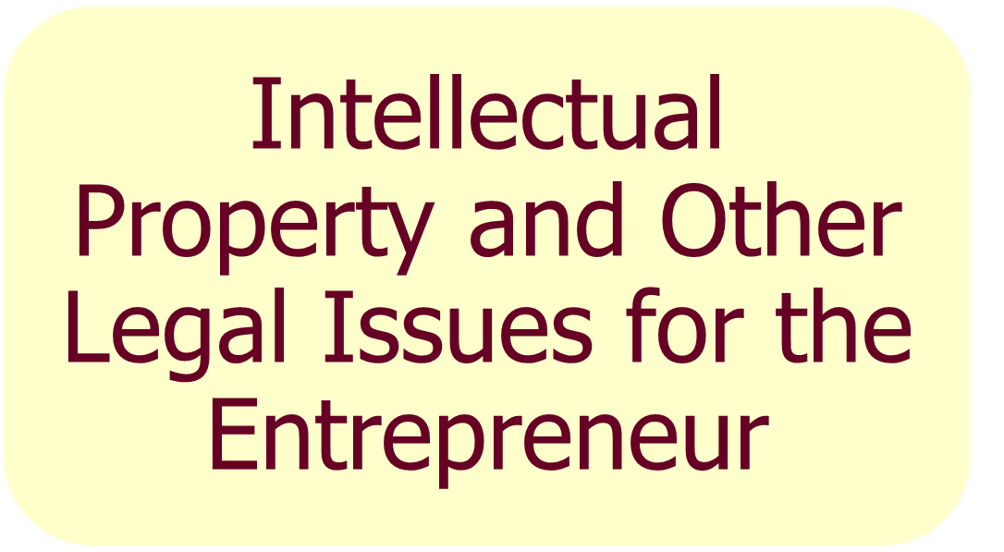
6
Chapter

Slide 2

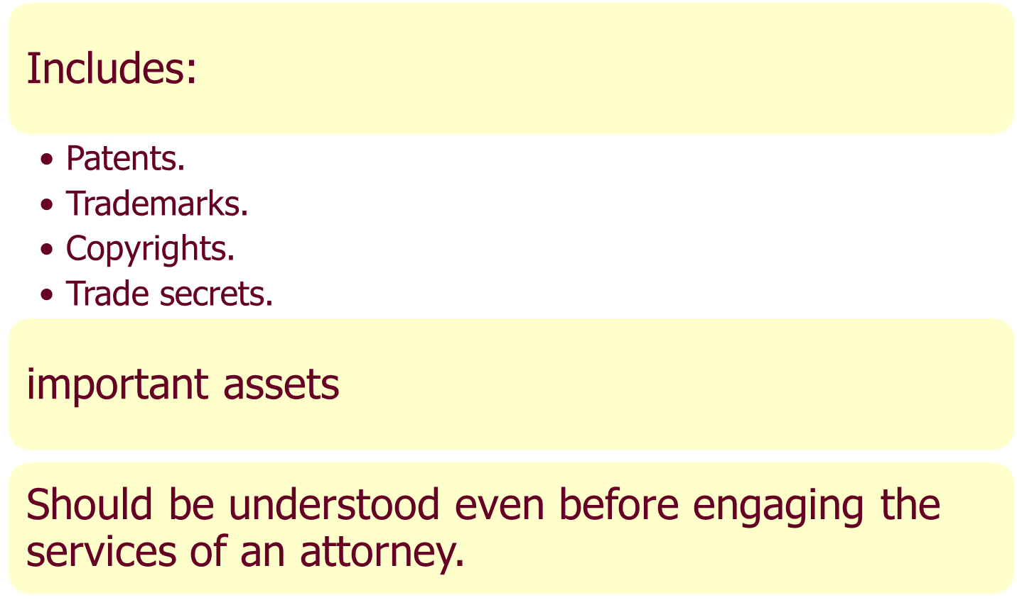

Intellectual Property

Slide 3

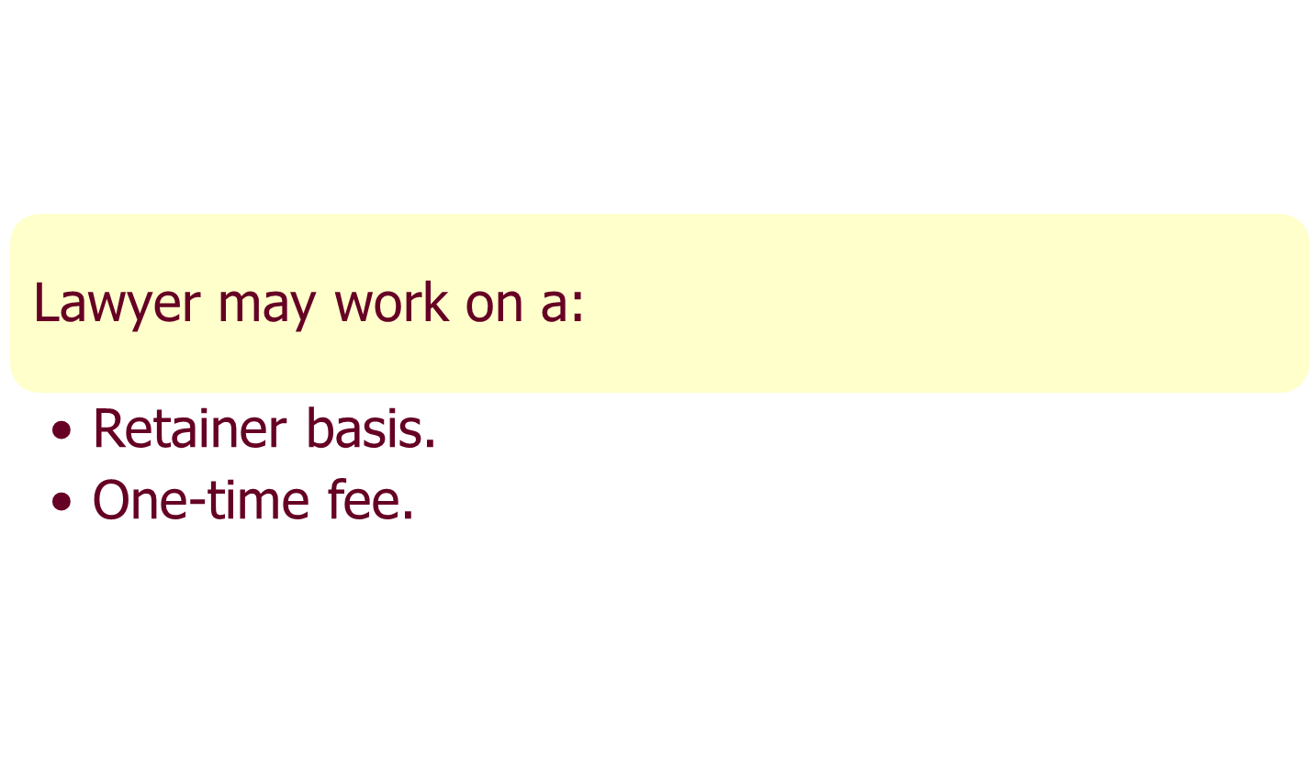
Selecting a Lawyer

Slide 4
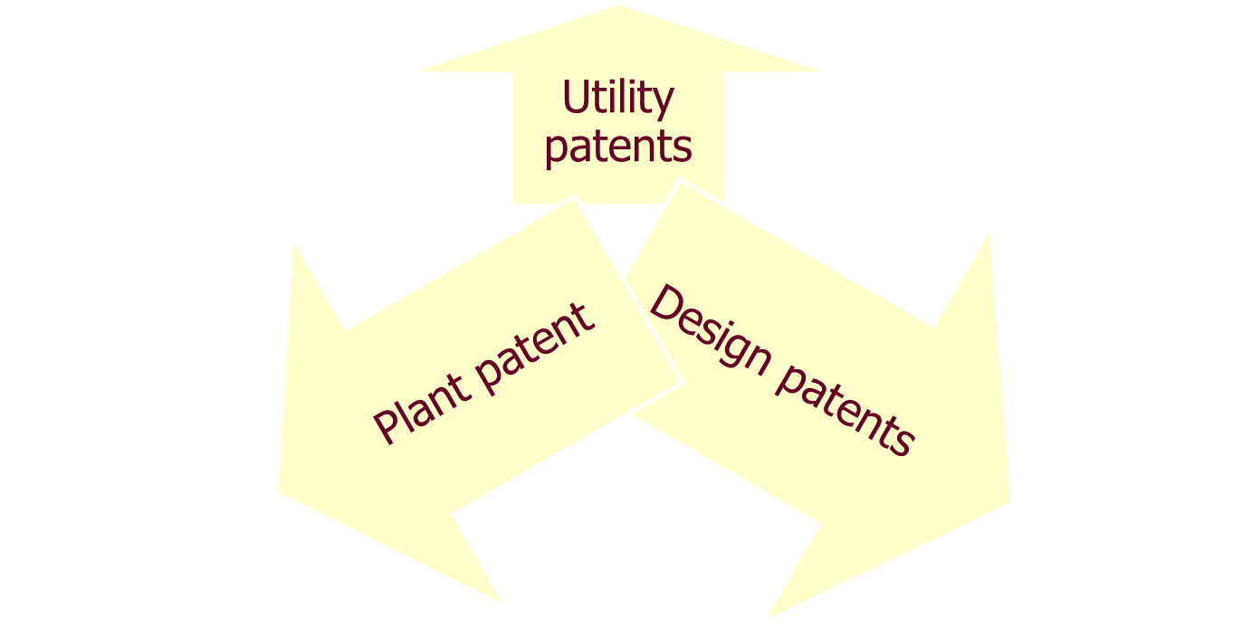
1) Patent: Protection from others making, using, or selling similar idea (invention, design etc)

Slide 5
Patent is the legal form between you and the Government about the business
For example I lunched a mendicancy and we patent no one can produce like this for next two year
Trademark: like Toyota logo ,design etc
Copyright : like video
TradeSecret :chemical

Slide 6
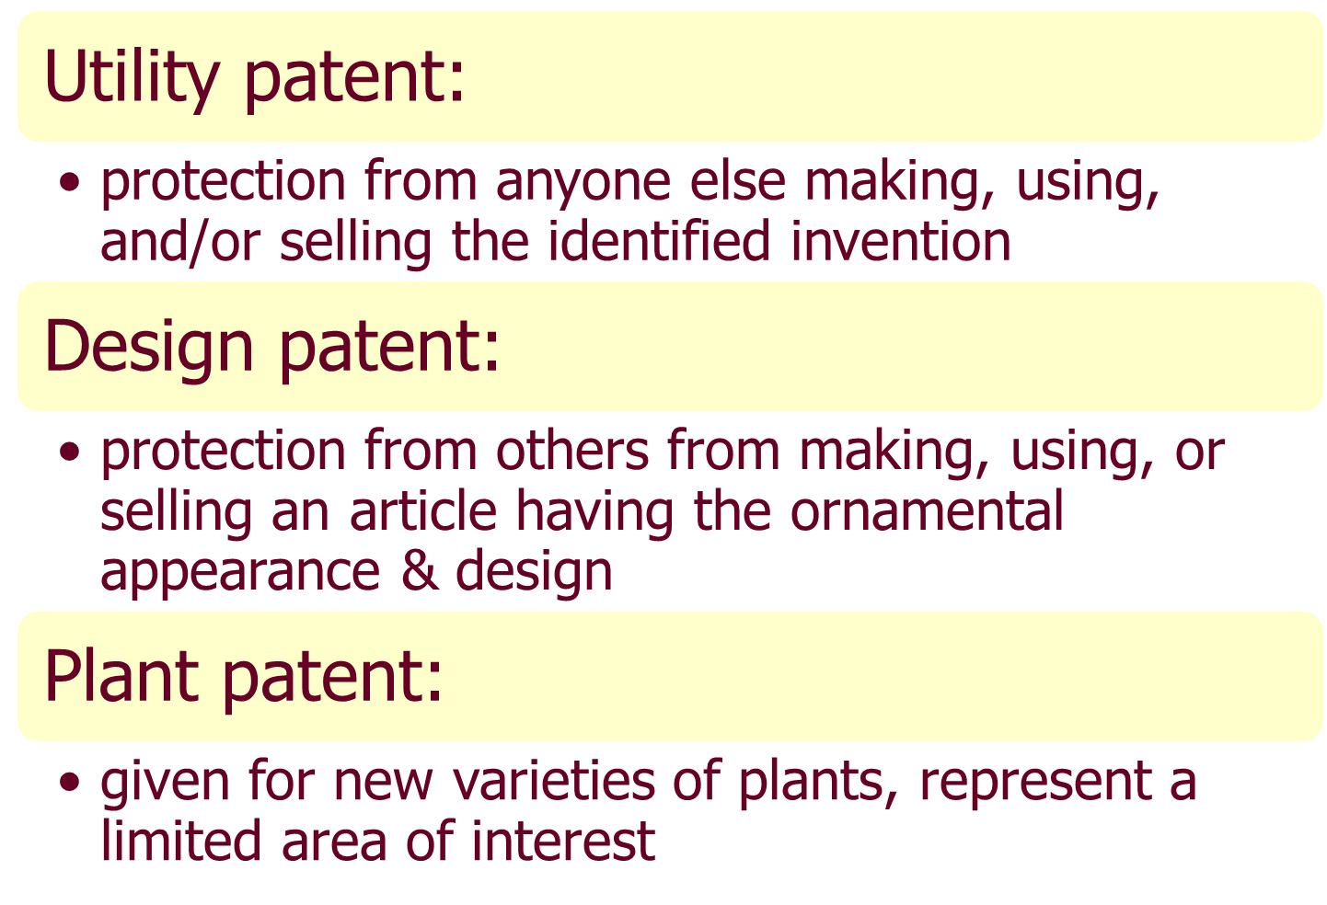

Slide 7

Global trade increasing--- difficult to maintain patent laws around the world
The Patent Cooperation Treaty (PCT) --- in global markets.
  Has over 100 participants.
  Facilitates patent filings in multiple countries in one office.
  Administered by the World Intellectual Property Organization (WIPO) in Geneva, Switzerland.
  Provides a preliminary search that assesses whether filing firm will face infringements in any country.
Significant differences may exists in patent laws in each of these countries.

Slide 8
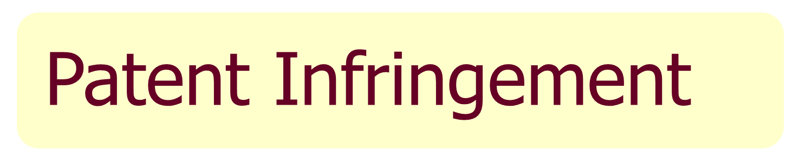
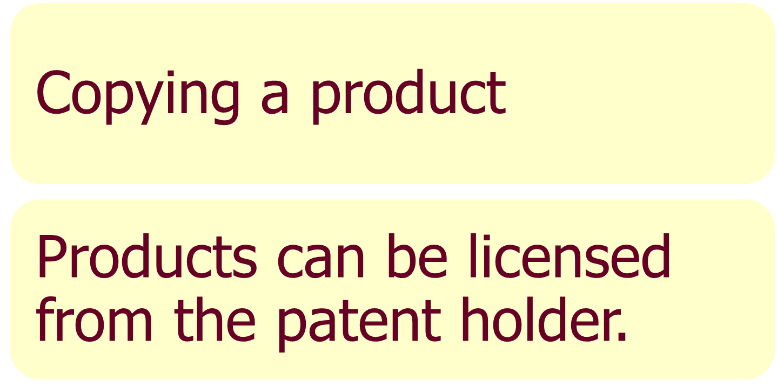

Slide 9

Toyota VS Geely

Slide 10



Slide 11
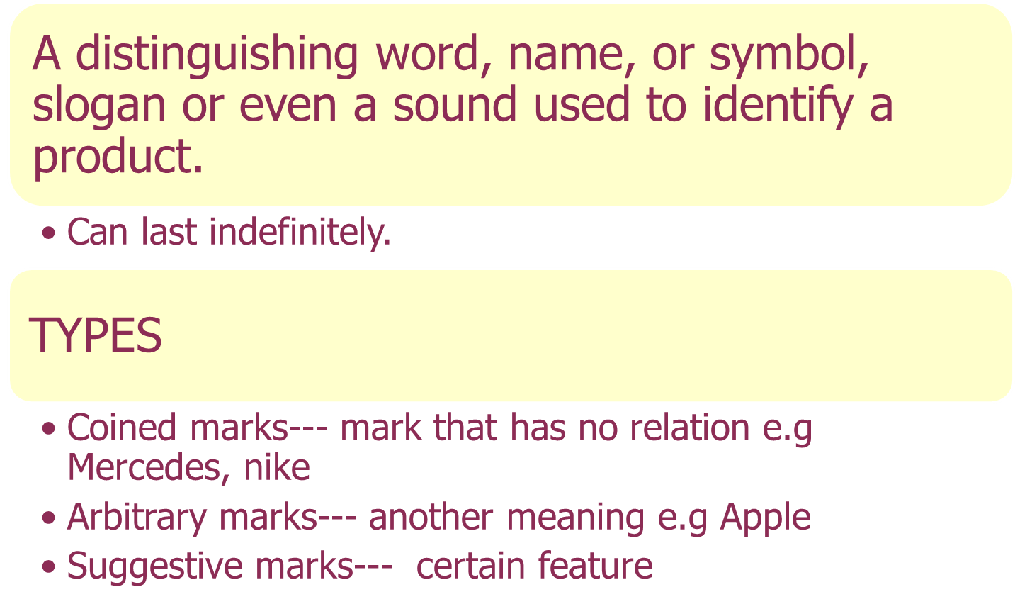
2) Trademarks

Slide 12
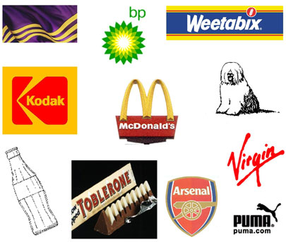

Slide 13


Slide 14

3) Copyrights
Right given to prevent others from printing, copying, or publishing any original works of authorship
  material on the Internet causing problems
  Example: Napster.
  Term of the copyright is the life of the author plus 70 years.

Slide 15




Slide 16

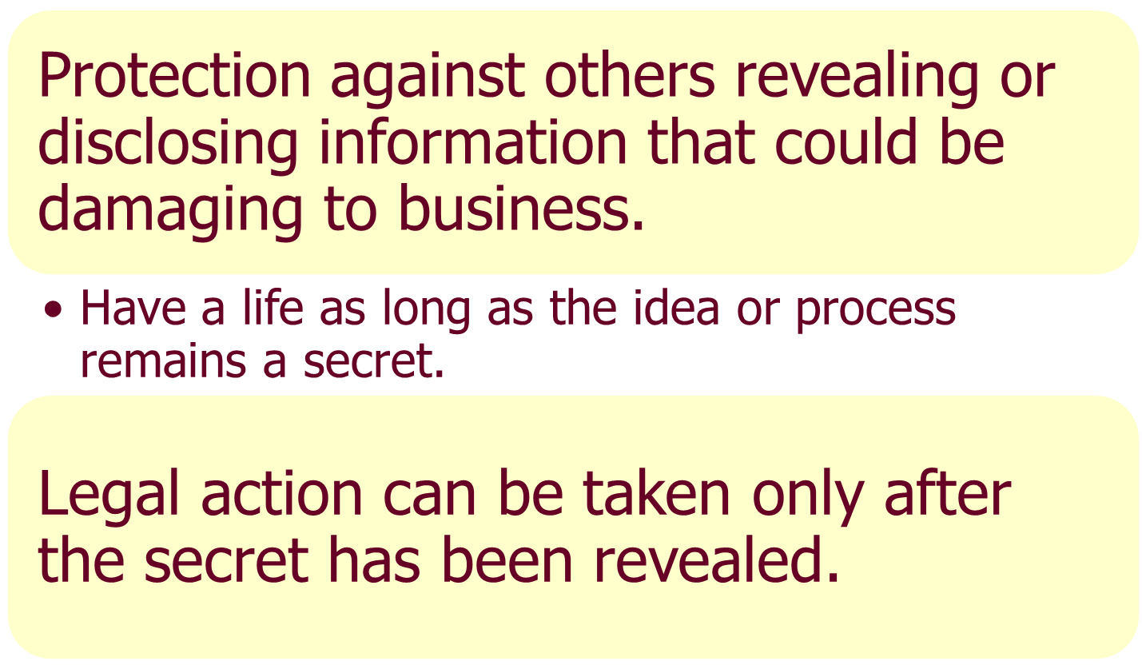
4) Trade Secrets

Slide 17
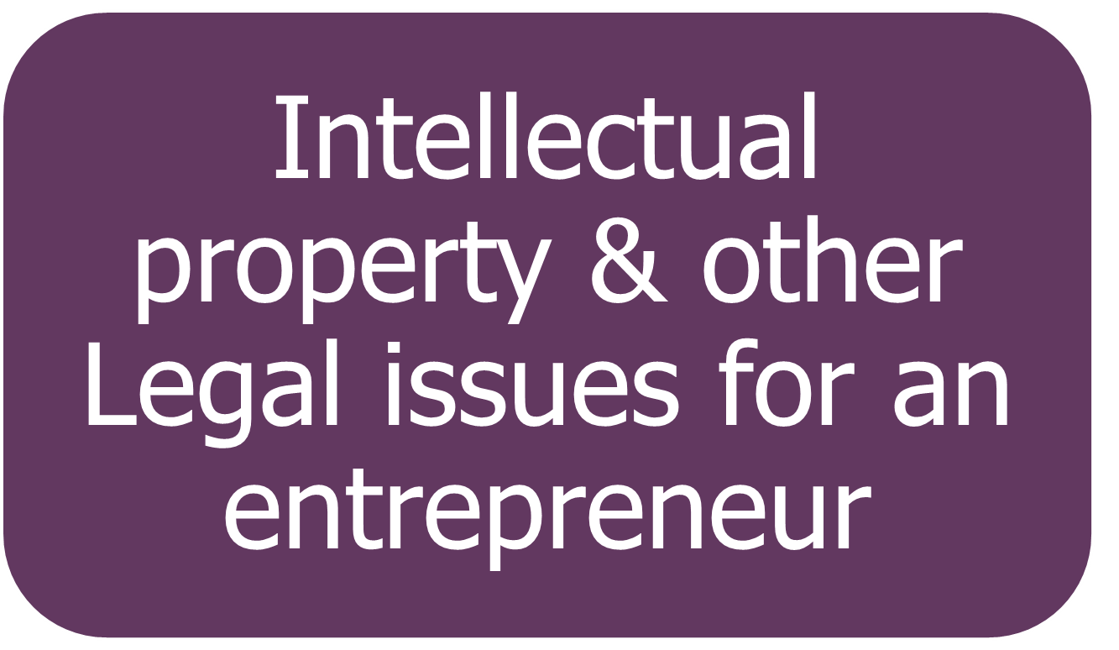

Slide 18


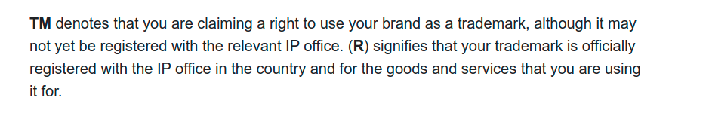
Difference between R in a
circle & TM
Under what heading the
recepies & formulas come e.g coka cola etc

Slide 19



Slide 20

Licensing
Contractual agreement --- rights to others to use intellectual property in return for a royalty or fee.
Type :
  Patent license agreement: specifies how the licensee would have access to the patent.
  Trademark: franchising
revenue boom

Slide 21

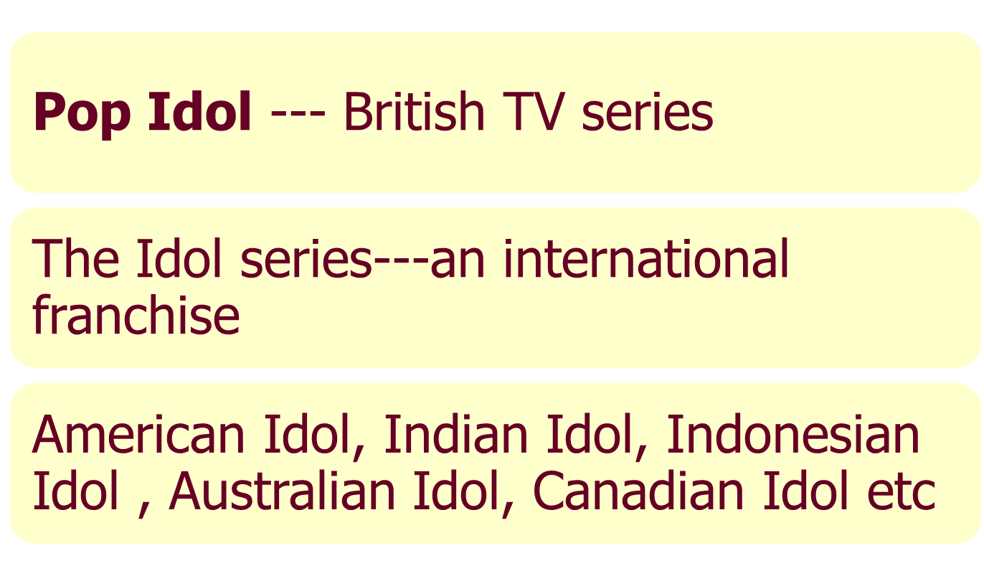

Slide 22
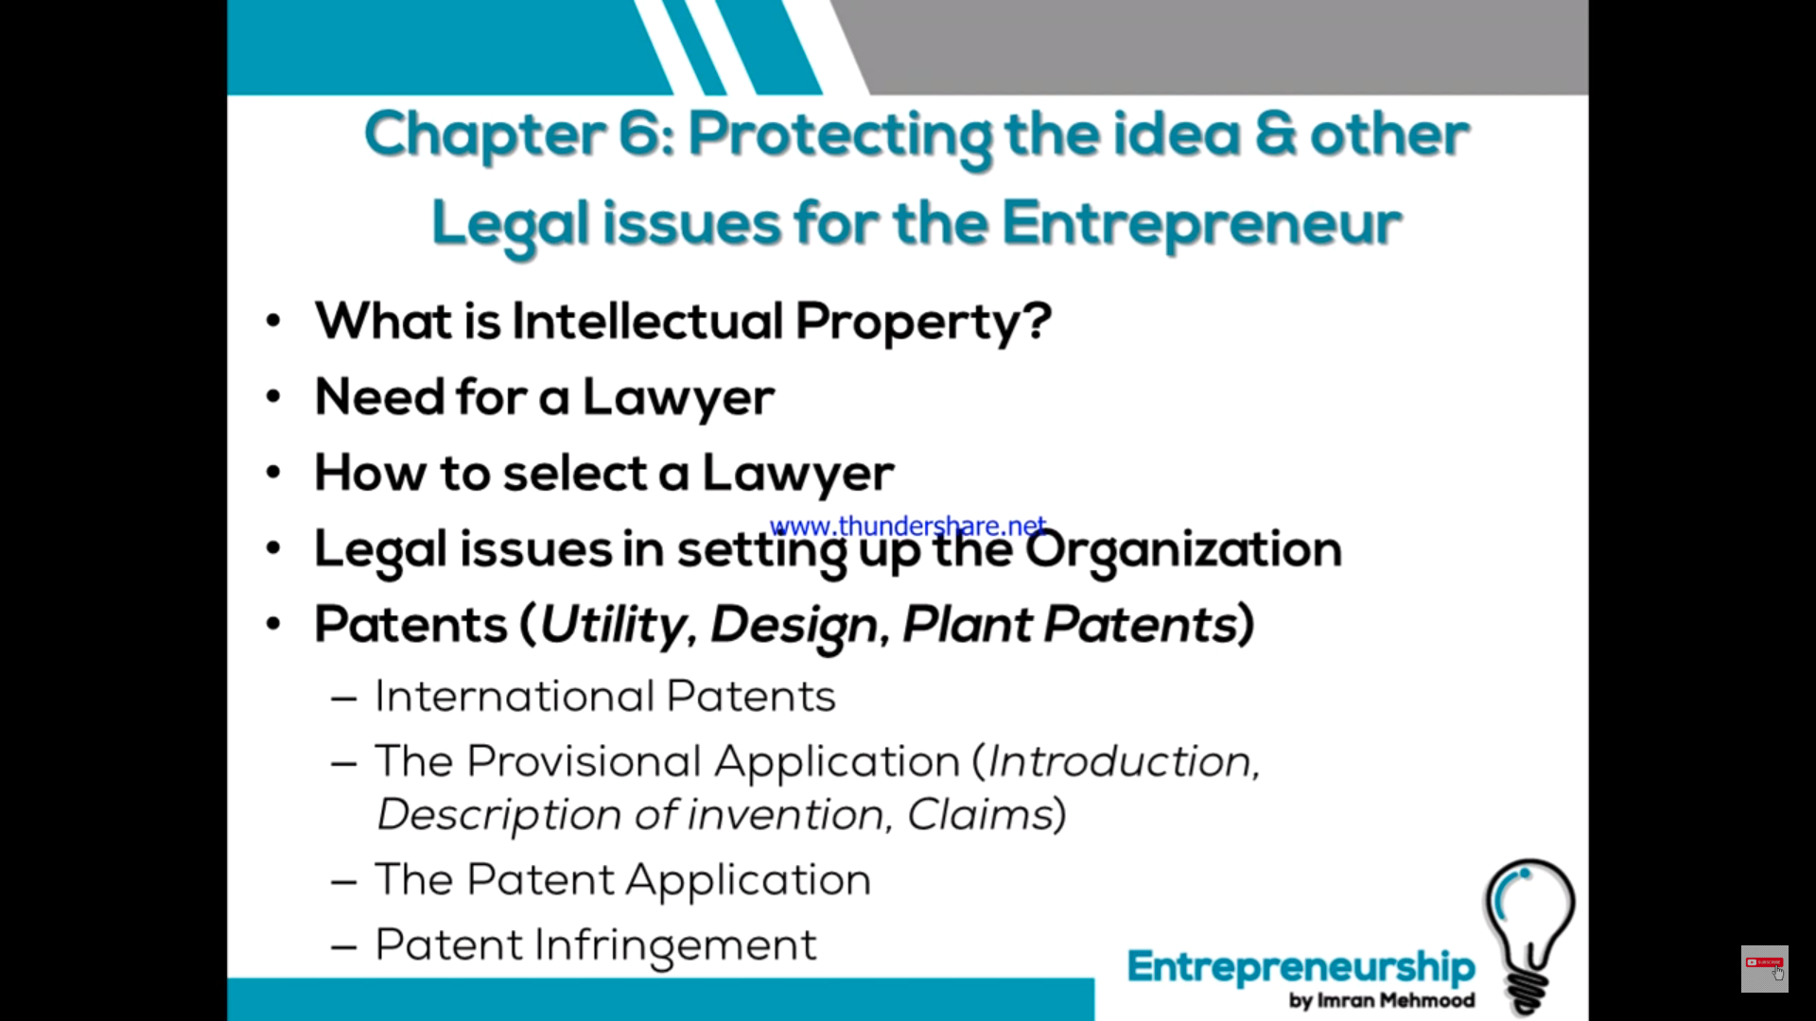

Slide 23
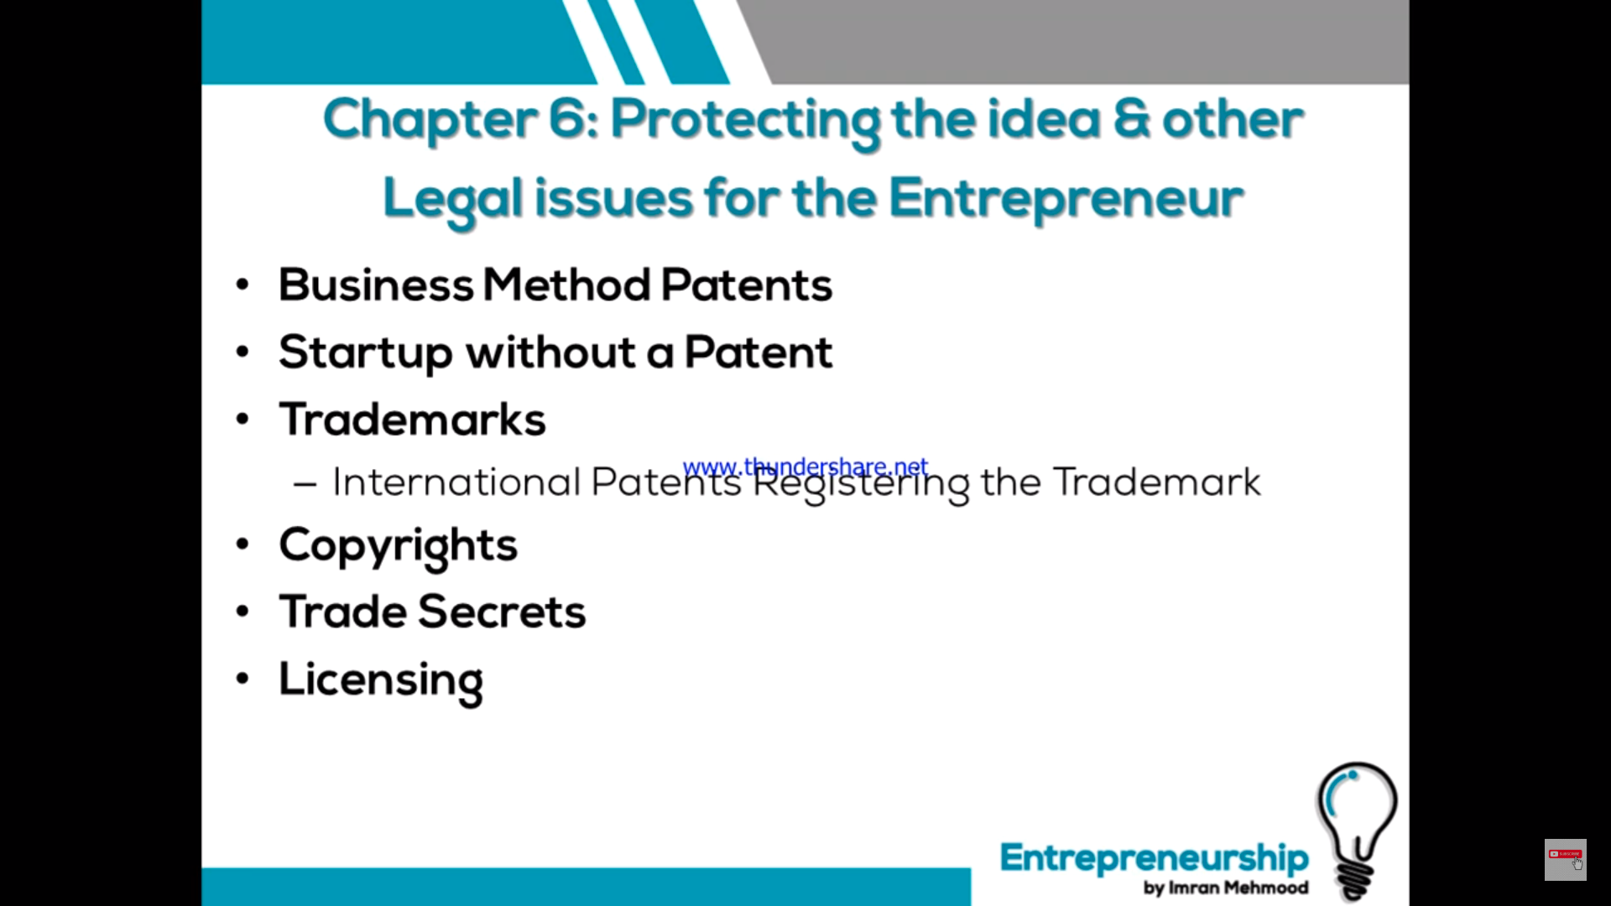

Slide 24
